Slide 1

Posters
Harty pp. 210-229, Hofman Ch. 27

Slide 2
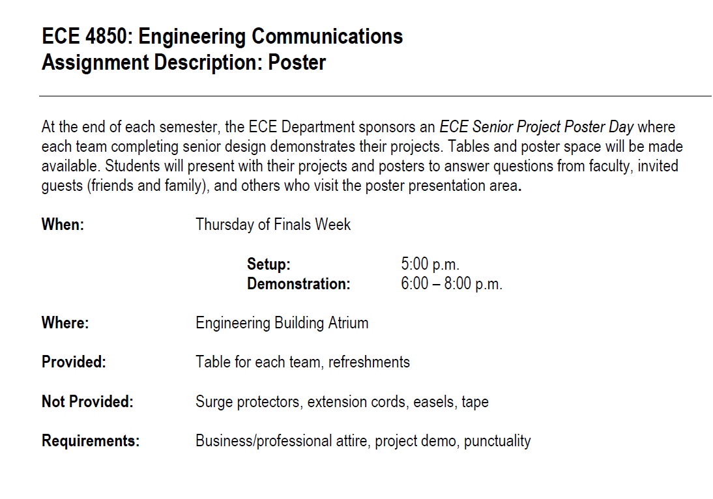

Slide 3
Content
Title
Project
System
Materials and methods
Results and Conclusion

Slide 4
Content
Scientific posters are judged by their content as well as by their presentation.
Effective poster design is therefore important.

Slide 5
Content
Concentrate only on the main points in each section.
Find visual ways to show your work; the illustrations tell the story.

Slide 6
Content
Use quad chart layout.
Aim for 20% text, 40% graphics, and 40% empty space.

Slide 7
Content
Use font sizes proportional to importance.
Title: 90 point, boldface
Subtitles: 72 point
Section headings (Introduction, etc.): 32-36 point
Other text: ideally 22-28 point

Slide 8
Title
Should convey the topic, approach, and system
Needs to attract reader’s attention
Should be no longer than two lines
Should be at least 2 inches tall

Slide 9
Project
Get your viewer interested in the issue or question while using the absolute minimum of background information and definitions.
Can be presented in bullet form (preferred).

Slide 10
Materials and Methods
Briefly describe experimental equipment and methods.
Let pictures tell the story (graphs, charts, diagrams, schematics)

Slide 11
Results
Describe your most important overall results.
Use charts and tables.
Show your data analysis (optional).

Slide 12
Conclusion
Assign importance to your results and summarize them accordingly.
Concentrate on your main findings and their interpretation.
Use bulleted lists.

Slide 13
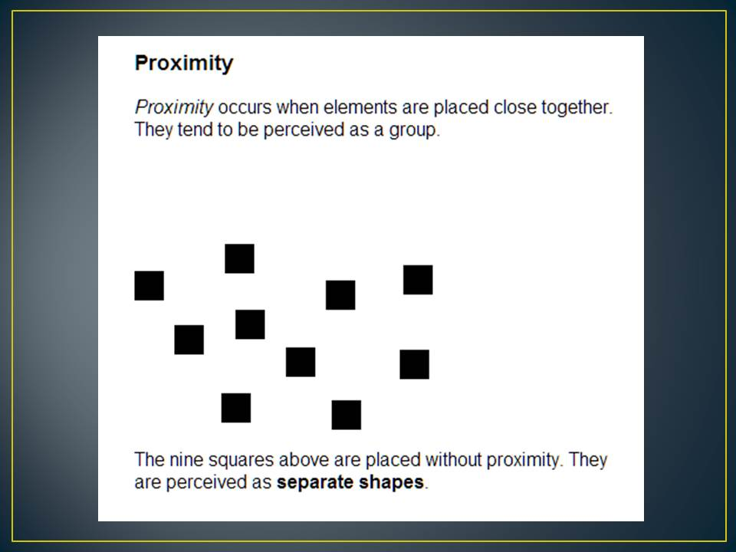

Slide 14
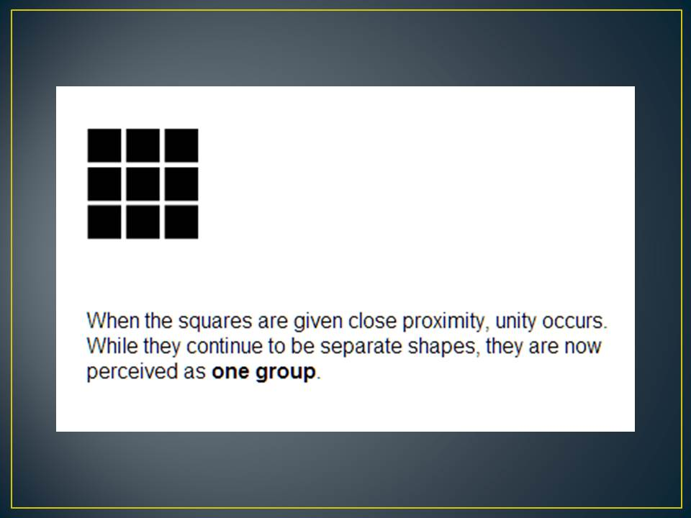

Slide 15
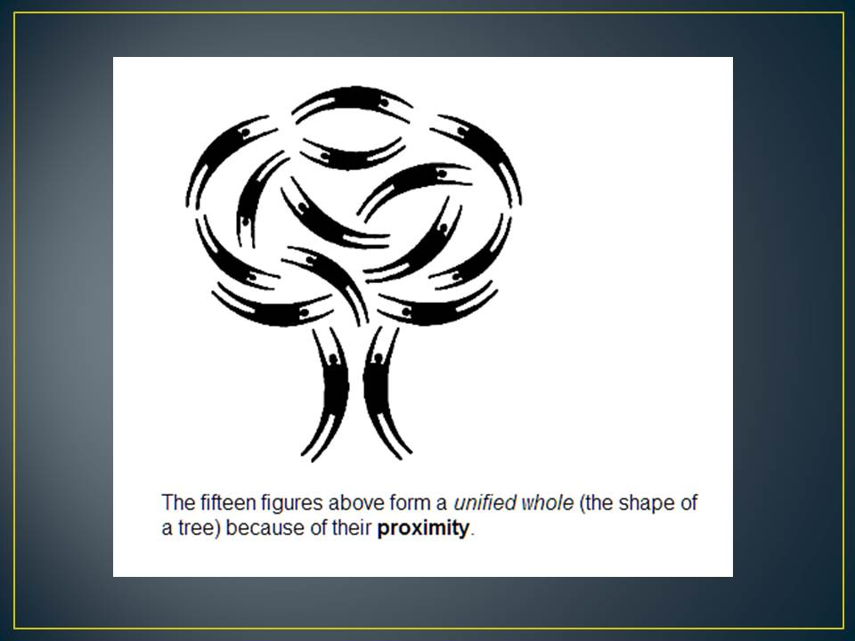

Slide 16
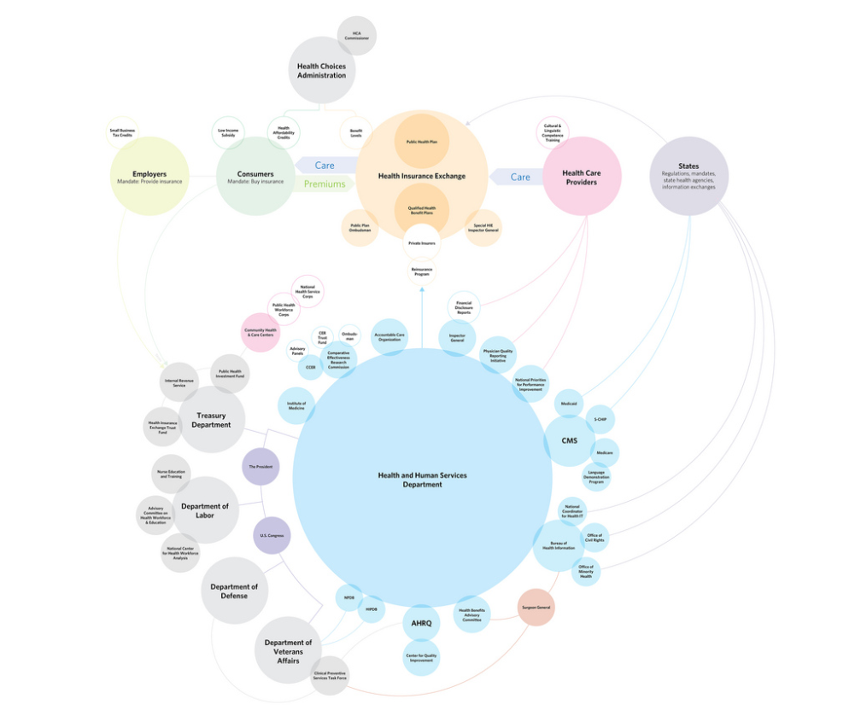
Democrat Version

Slide 17
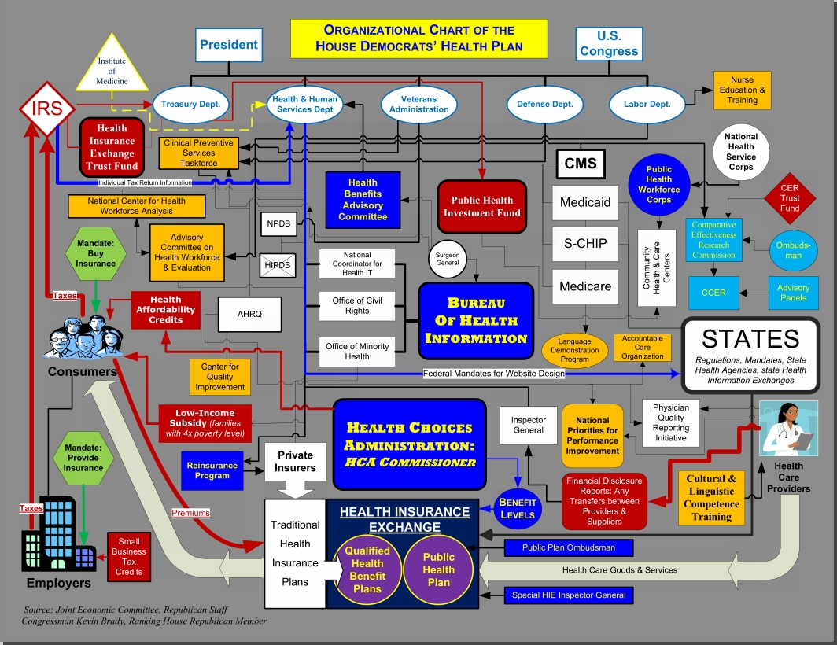
Republican version

Slide 18
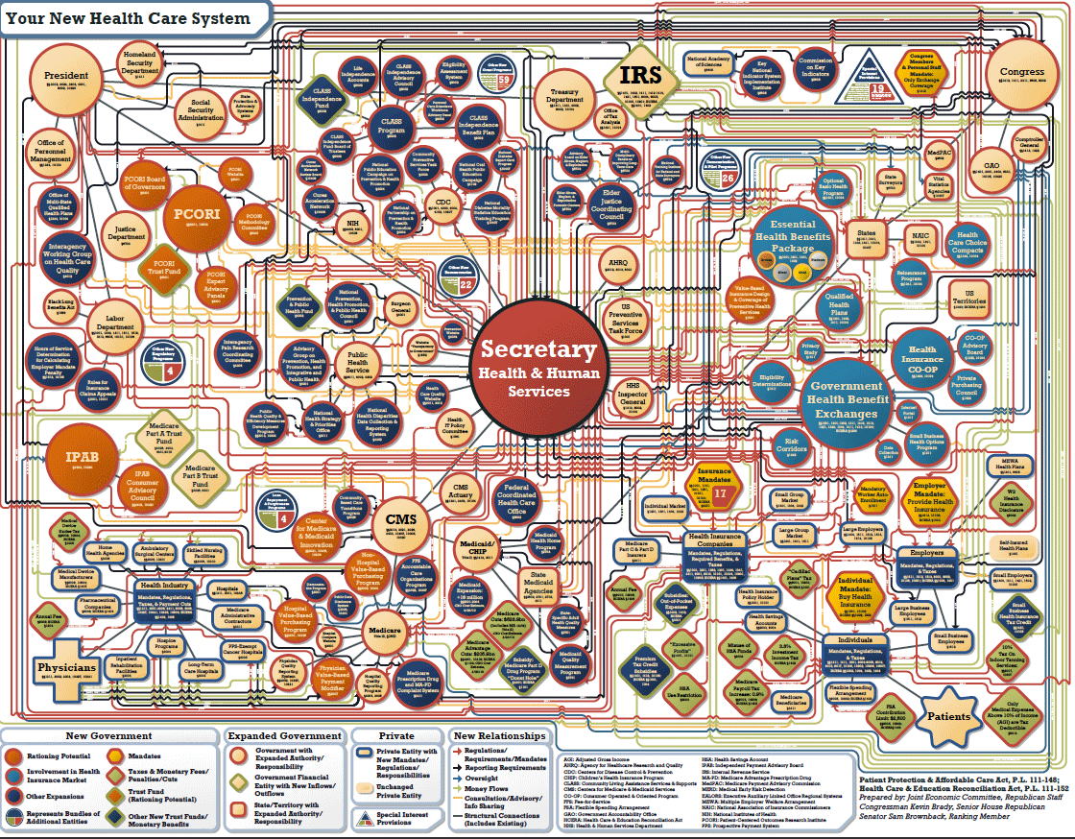
Another Version
https://designhash.wordpress.com/2012/09/14/anti-information-graphic/
Notes:
Another Republican version, this time from the Joint Economic Committee.

